Slide 1


Investigation of the Germline Variation in Swedish Flat-Coated Retrievers
Sophie Agger, DVM, PhD student
Supervisors:
Associate professor Maja Arendt, DVM, PhD, DipECVIM-CA(onc) Professor Annemarie T. Kristensen, DVM, PhD, DACVIM-SA, DipECVIM-CA, DipECVIM-CA(onc)
Professor Kerstin Lindblad-Toh, PhD

Slide 2
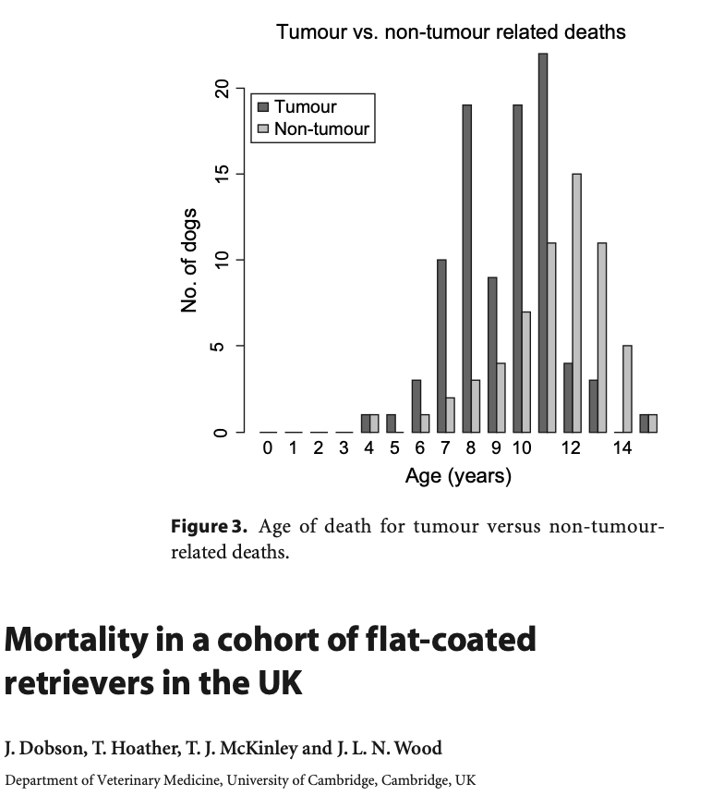
Flat-Coated Retriever health and disease surveillance study
Studied in the UK since 90’s
Predisposed to
Eyes: PLA/PRA
Renal dysplasia
Cancer (50-68% dies of cancer)
Sarcomas
Malignant melanoma
Lymphoma
Histiocytic sarcoma (15-20% develops it)
Notes:
Statistics of Swedish FCR*:
Median age at death 8.1 (all breeds 7.4)
Increased risk of cancer related death
HD has been increasing

Slide 3
Flat-Coated Retriever health and disease surveillance study
In 2011 a study to surveil the Swedish FCR population and collect genetic material was started as a collaboration between Uppsala University, and the Swedish Flatcoated Retriever Club. The study is funded by the Agria & SKK research fund.
The goal of the study is to increase knowledge about the diseases affecting the breed in Sweden and an increased understanding of the genetic makeup of the breed.
Promote a healthier breed
Notes:
Uppsala university and the Swedish Flat-coated retriever club started a project to surveil the Swedish FCR populations and to collect genetic material for future studies.
In 2011 a large project grant was given from the Swedish kennel club and the Agria insurance company to support the project
The project is prospective and has been planned to run over 10 years. It is expected to provide a lot of information regarding disease prevalence and co-occurrence in the breed.
Statistics of Swedish FCR*:
Median age at death 8.1 (all breeds 7.4)
Increased risk of cancer related death
HD has been increasing

Slide 4
Flat-coated Retrievers – Whole genome sequencing
In order to describe the genetic background of Swedish FCR, 19 dogs had whole genome sequencing performed
Aim:
To investigate allele frequencies of variants already correlated to different phenotypes
CDK5RAP2 and histiocytic sarcoma
EYA1 and retinal dysplasia
Among others
To investigate if any variants are fixed in the Flat-coated Retrievers compared to other breeds

Slide 5
Genetic analysis
Cases
19 Swedish Flat-Coated Retriever
Controls for F-statistics
160 Swedish and American dogs
Phenotype | #
Behavior | 8
Histiocytic Sarcoma | 6
Geriatric Control | 4
Cataract* | 1
Renal Dysplasia | 1
Total | 19
Breeds | #
Beagle | 20
Cavalier King Charles Spaniel | 20
German Shepherd | 20
Golden Retriever | 20
Labrador Retriever | 20
Standard Poodle | 20
Rottweiler | 20
West Highland White Terrier | 20
Total | 160
* This dog also had the phenotype ”Behavior”

Slide 6
Flat-coated Retrievers – Alignment and Variant calling
Filters | SNP | INDELS
QD | < 2.0 | < 2.0
FS | > 60 | > 200
SOR | > 3.0 | > 10.0
MQ | < 40.0
QD | < 2.0
FS | > 60.0
MQRankSum | < -12.5
ReadPosRankSum | < -8.0 | < -20
Max maf | 0.99992
The NBISweden K9-WGS-Pipeline:
fastqc-0.11.5 - quality control
bwa-0.7.12 - alignment
samtools-1.5 – sorting and improving lookup
picard-2.10.6 – preprocessing
gatk-3.5 – preprocessing and variant calling
htslib-1.5 – compressing and indexing
vcftools-0.1.15 – file handling – subsetting etc.
bcftools 1.10 – file handling – subsetting etc.
plink 1.90b4.9 – statistics – F_{ST} and frequencies
Notes:
Samtools: Sorting by coordinates. Index cfreates a coordinated sorted index for fast lookup of specific areas.
Mark duplicates – picard: finds duplicate reads and tags them. Duplicates are basically mistakes and can be due to f.eks. PCR duplication or an amplification cluster being detected as 2 clusters. It also makes a metrics/summary file.
Baserecalibration - Gatk: Makes table of recalibration based on your input, it’s function is to find systematic errors by the sequencing machine, with machine learning it adjust the quality. It improves our variant calling later on, because we’re more sure about the quality of the data we’re basing it on. It has 2 steps, first it makes a model and then it applies it to the data. https://gatk.broadinstitute.org/hc/en-us/articles/360035890531-Base-Quality-Score-Recalibration-BQSR- make these graphs.

Slide 7
Flat-coated Retrievers – Alignment and Variant calling
Filters | SNP | INDELS
QD | < 2.0 | < 2.0
FS | > 60.0 | > 200.0
SOR | > 3.0 | > 10.0
MQ | < 40.0
QD | < 2.0
FS | > 60.0
MQRankSum | < -12.5
ReadPosRankSum | < -8.0 | < -20
Max maf | 0.99992
QD: Quality of Depth
Normalized variant quality based on sequencing depth
Measure for how much we trust it.
FS: FisherStrand
The chance of an al. allele is seen on one strand versus the other.
Handles incorrect evaluation of evidence present based on strand bias
SOR: StrandOddsRatio
Other measure of strand bias
Handles exon ends better than FS
MQ: RMSMappingQuality
Estimates the overall mapping quality over all samples
MQRankSum
Compares mapping qualities of ref and alt. alleles – should be equal but we accept that the alt. allele has better score
ReadPosRankSum
Compares if the position of ref/alt. Alleles are the same between reads
End of reads are less certain
Notes:
With the produced variant-caller file, now it’s possible to apply filters to only use the SNPs and indels we actually believe to be true.
QD: avoids inflation
ReadPosRankSum: If ref/alt. al are found close to ends or the same distribution.

Slide 8
Flat-coated Retrievers
Annotation of variants
Investigate effects of any variants in the data set
F-statistics
Fixation of variants in the FCR population
Gene Ontology analysis
Does any known pathways have an increased # of variants with Z(F_{ST})>5
Candidate genes
Investigation of variants with a known correlation with/effect on phenotypes

Slide 9
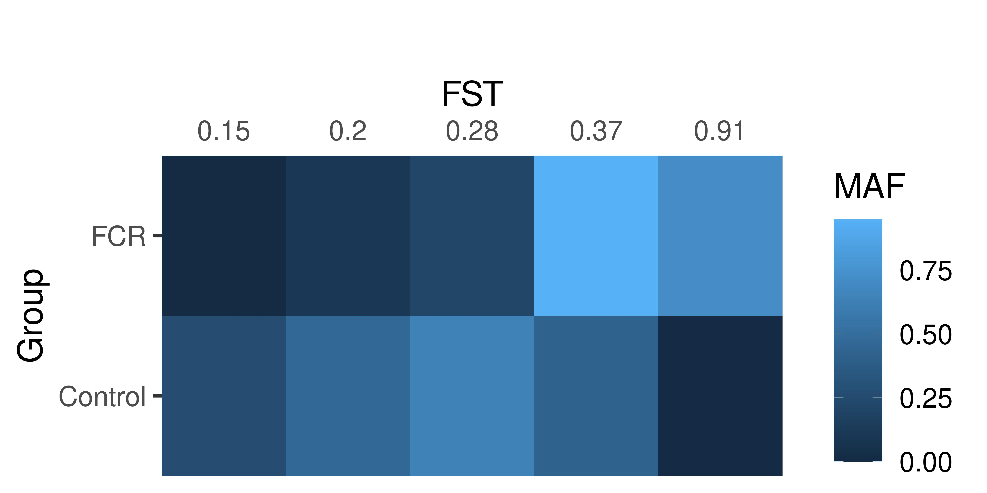
F-statistics
What is it?
F-statistics is a way to investigate population differentiation.
A measure of departure from Hardy-Weinberg expectations
chr1:83307092
chr1:83315440
chr1:83358092
chr1:83394602
chr1:83421285
Notes:
Investigates the variance of MAF between populations
Max 4% of observations is more than 5 σ away from the median if normal distributed
If anyone wants to know more, I have found an absolutely brilliant article about it. “Genetics in geographically structured populations Defining, estimating and interpreting FST - Holsinger, Weir – 2009”

Slide 10
F-statistics
What is it?
F-statistics is a way to investigate population differentiation.
A measure of departure from Hardy-Weinberg expectations
Method
The F_{ST} was calculated per SNP
F_{ST} was normalized
5 σ was set as significance level
chr1:83307092
chr1:83315440
chr1:83358092
chr1:83394602
chr1:83421285
Notes:
Investigates the variance of MAF between populations
Max 4% of observations is more than 5 σ away from the median if normal distributed
If anyone wants to know more, I have found an absolutely brilliant article about it. “Genetics in geographically structured populations Defining, estimating and interpreting FST - Holsinger, Weir – 2009”

Slide 11
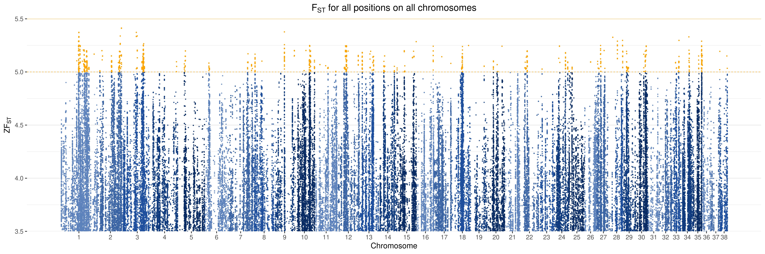
Results – F_{ST} – Unpruned dataset
Notes:
15-20% dies of the disease

Slide 12
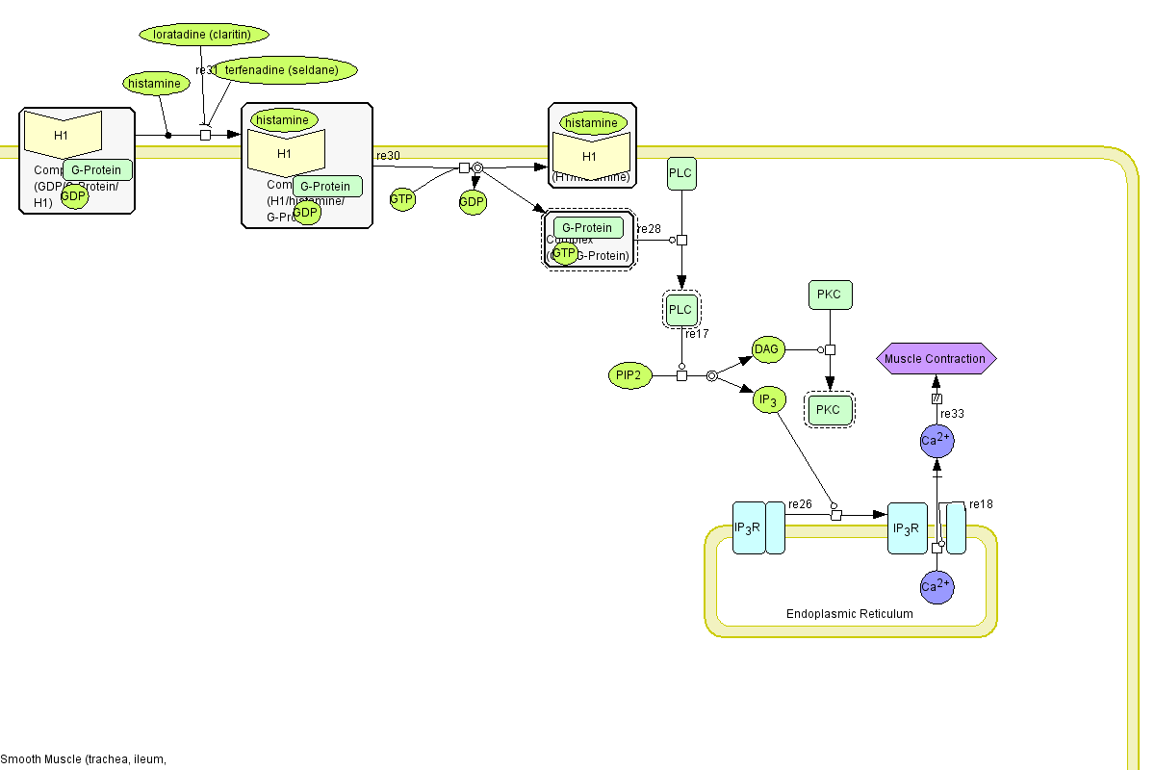
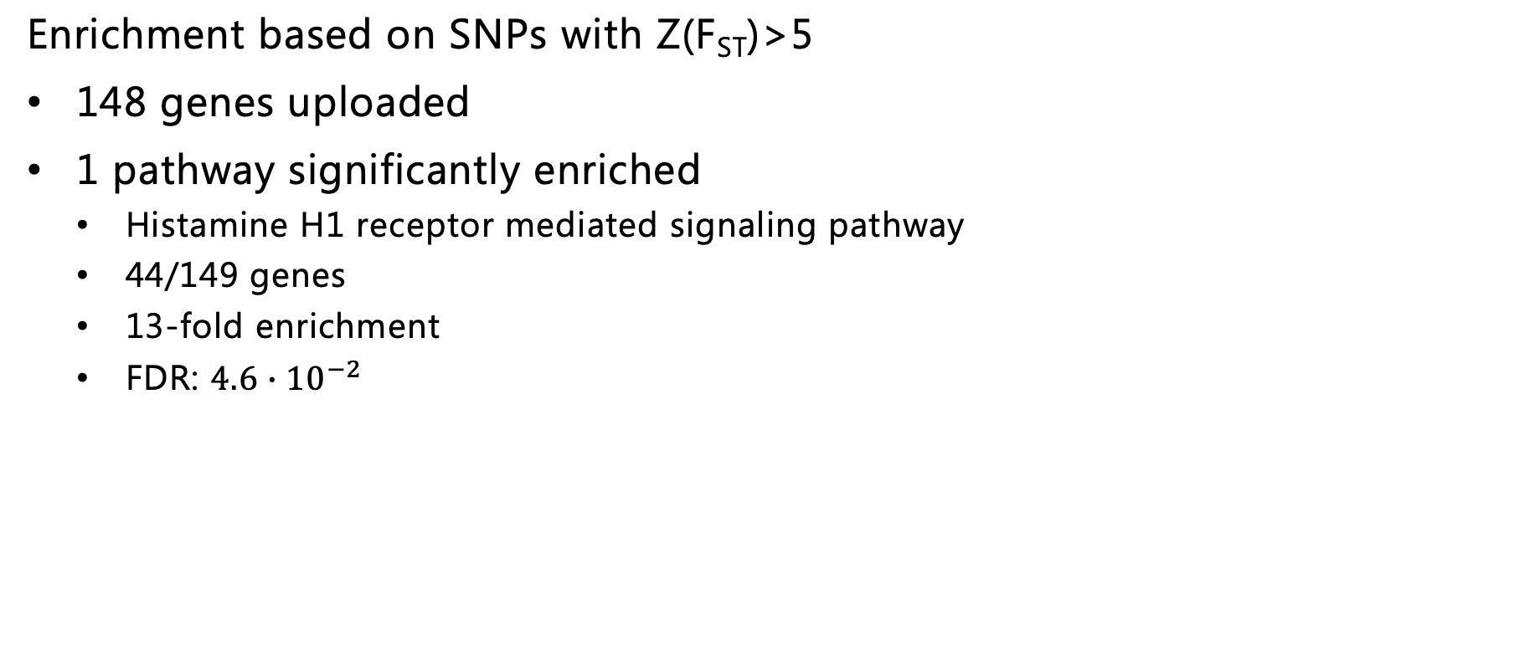
Gene ontology
Enrichment based on SNPs with Z(F_{ST})>5
148 genes uploaded
1 pathway significantly enriched
Histamine H1 receptor mediated signaling pathway
44/149 genes
13-fold enrichment
FDR: ${4.6∙10}^{−2}$

Slide 13
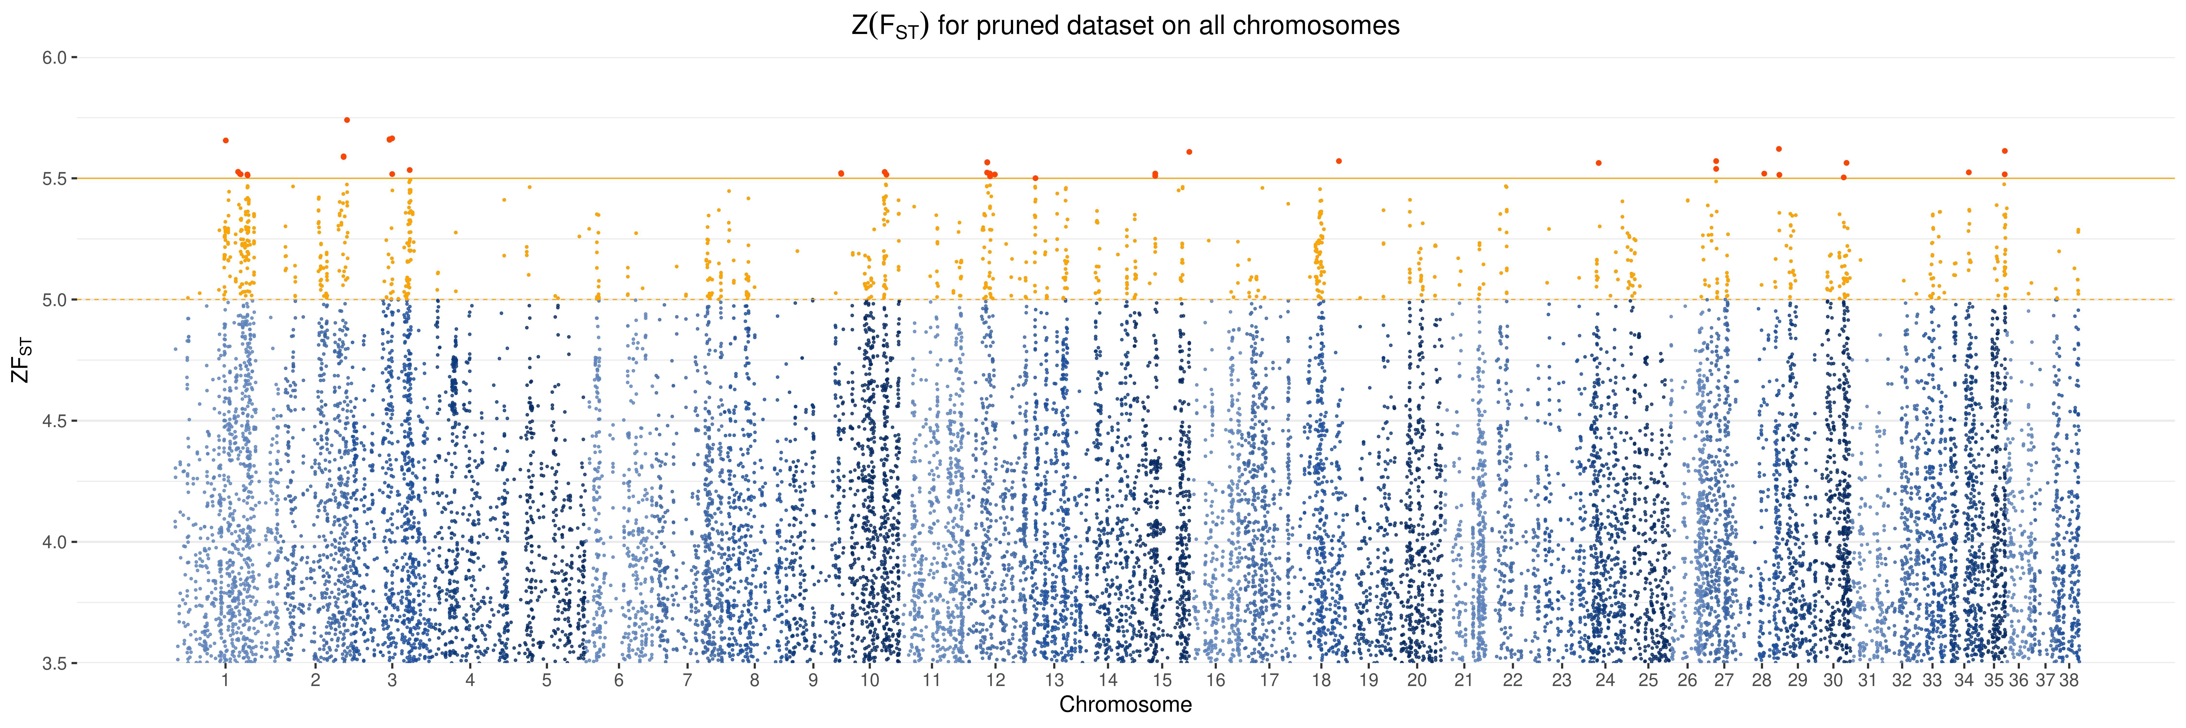
Results – F_{ST} – Pruned dataset
Genes*
CFAP46
GPX5
KHDC3L
MCTP2
NBL1
NRXN1
OS9
R3HDM2
RCAN3
SLC2A13
STK32C
THSD4
TRPM3
*Genes with SNPs where Z(F_{ST}) > 5.5
Notes:
15-20% dies of the disease

Slide 14
Candidate genes (All data from 24/2/20)
Based on prior knowledge from human/mice/dogs
COSMIC
20 most common mutated genes associated with CMML (s+g)
20 most common genes with somatic mutations associated with cancer
20 most common genes with germline variants associated with cancer
Diseases
Variants correlated with
Histiocytic disease
Patella luxation
Renal dysplasia
Many others

Slide 15
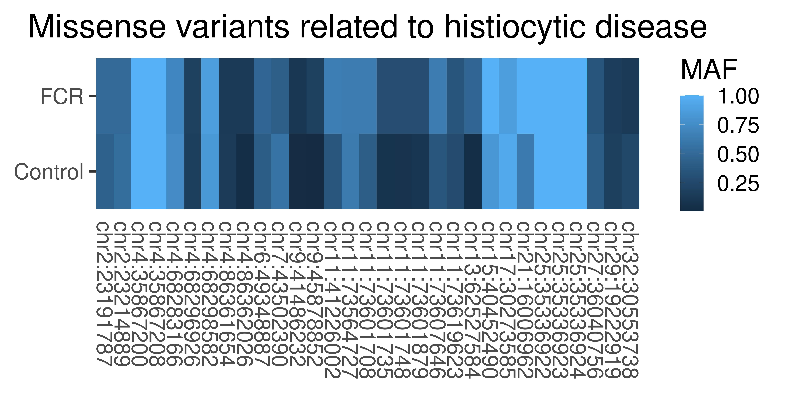
Genes related to Histiocytic disease (43 genes)
Variants with MAF_{FCR}≥0.1)
4920 variants in total
31 missense variants
CDK5RAP2
C6
DOK2
PHYH
BASP
DOK3
SERPINF2
PPBP
NF1
CYP1B1
S100A8
ENPEP
CDKN2B
NCOA2
VCAM1
PCF11
SPI-C
CLEC12A
ASPN | BACH2 | BASP1 | BRAF | C6 | CCL5 | CD9 | CDK5RAP2 | CDKN2A | CDKN2B | CLEC12A | Col3A1 | CYP1B1 | DCTN4 | DENND2C | DOK1 | DOK2 | DOK3 | ENPEP | GTSF1 | JCHAIN
KIF2C | LUM | MYC | NCOA2 | NF1 | PCF11 | PHYH | PIK3CA | PPBP | PTEN | PTPN11 | RAF1 | RB1 | S100A12 | S100A8 | SERPINF2 | SPIC | THY1 | TKTL1 | TP53 | VCAM1
Notes:
skriv navne på Highlight
Publikationer ud af dataen
Hvilke som mut review generelt.
Andet review?
cfDNA scoping review.
Som, germ,

Slide 16
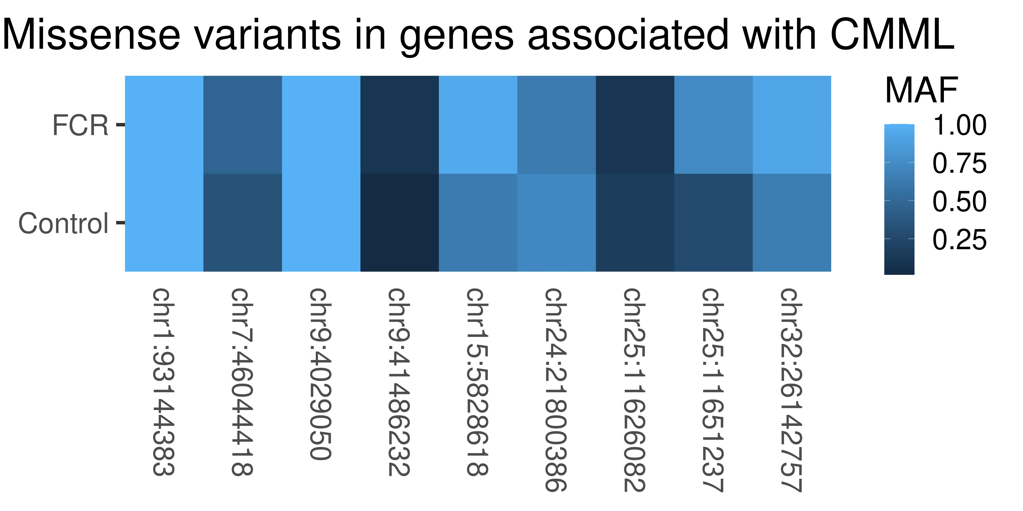
Genes related to CMML (20 genes)
Variants with MAF_{FCR}≥0.1)
2716 variants in total
9 missense variants
FLT3
SRSF2
ASXL1
TET2
FAT1
CSF3R
JAK2
NF1
ASXL1 | CBL | CSF3R | DNMT3A | EZH2 | FLT3 | IDH2 | JAK2 | KRAS | NF1
NPM1 | NRAS | PTPN11 | RUNX1 | SETBP1 | SF3B1 | SRSF2 | TET2 | U2AF1 | ZRSR2
Notes:
Regulates hematopoiesis
Publikationer ud af dataen
Hvilke som mut review generelt.
Andet review?
cfDNA scoping review.
Som, germ,

Slide 17
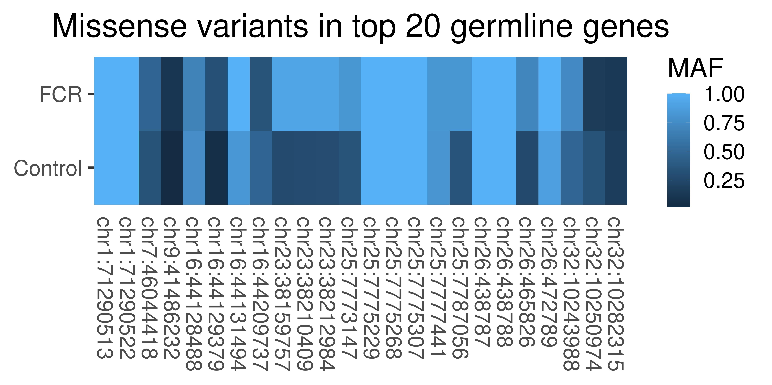
Top 20 most common germline variants associated with cancer
Variants with MAF_{FCR}≥0.1
9268 in total
24 missense variants
BRCA2
FAT1
POLE
PTCH1
ATR
PTPN13
NF1
SETBP1
ALK | APC | ATR | BRCA2 | CDH1 | CDKN2A | EGFR | ERBB4 | FAT1 | KDR
NF1 | PDGFRA | POLE | PTCH1 | PTEN | PTPN13 | RB1 | SETBP1 | SMAD4 | TP53
Notes:
Only 3 homozygotes controls, 1 fcr.
Control 3 hom, 8 het and 143 hom ref
1 10 8
Not investigated paralogues yet
Publikationer ud af dataen
Hvilke som mut review generelt.
Andet review?
cfDNA scoping review.

Slide 18
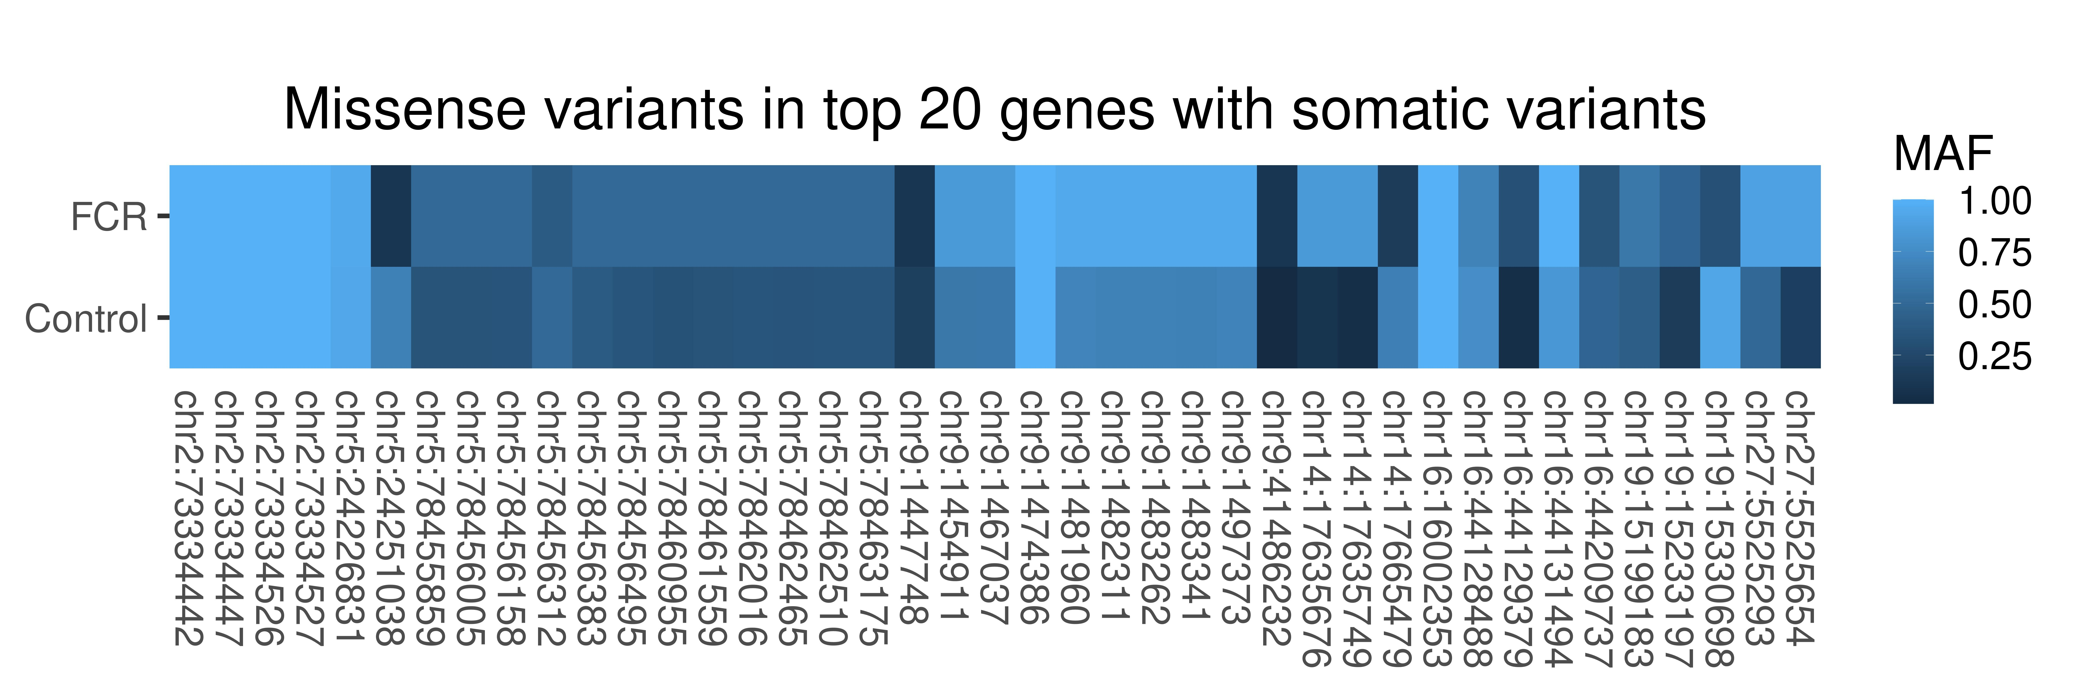
Top 20 genes most common genes with somatic variants
ASPN | BRAF | C6 | CCL5 | CD9 | CDKN2A | CDKN2B | CLEC12A | Col3A1 | ENPEP | GTSF1 | JCHAIN | LUM | PHYH | PIK3CA | PPBP | PTEN | PTPN11 | RB1 | S100A12 | S100A8 | SPIC | THY1 | TKTL1 | TP53 | VCAM1 | DOK1 | CYP1B1 | NF1 | MYC | MYC | RAF1 | BACH2 | PCF11 | DENND2C | SERPINF2 | NCOA2 | DCTN4 | KIF2C | BASP1 | DOK2 | DOK3
Variants with MAF_{FCR}≥0.1
4194 in total
41 missense variants
ZFHX3
RNF213
ARID1A
FAT1
ATM
AKAP9
FAT4
NF1
KMT2D
KMT2C
AKAP9 | APC | ARID1A | ATM | ATRX | BRAF | FAT1 | FAT4 | GRIN2A | KMT2A
KMT2C | KMT2D | KRAS | NF1 | PIK3CA | PTEN | RNF213 | TP53 | TRRAP | ZFHX3
Notes:
serine/threonine kinase and DNA damage sensor, activating cell cycle checkpoint signaling upon DNA stress
Only 3 homozygotes controls, 1 fcr.
Control 3 hom, 8 het and 143 hom ref
1 10 8
Publikationer ud af dataen
Hvilke som mut review generelt.
Andet review?
cfDNA scoping review.

Slide 19
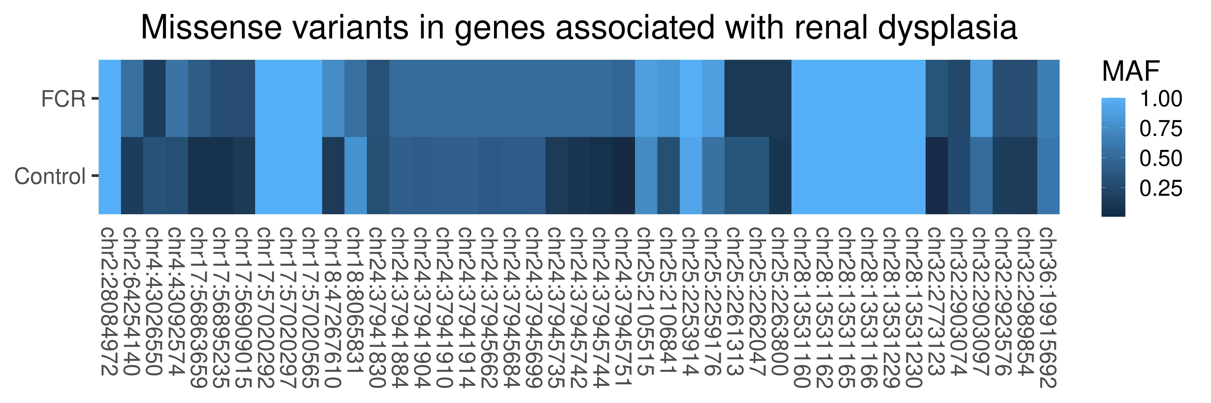
Variants in genes associated with renal dysplasia (45 genes)
ASPN | BRAF | C6 | CCL5 | CD9 | CDKN2A | CDKN2B | CLEC12A | Col3A1 | ENPEP | GTSF1 | JCHAIN | LUM | PHYH | PIK3CA | PPBP | PTEN | PTPN11 | RB1 | S100A12 | S100A8 | SPIC | THY1 | TKTL1 | TP53 | VCAM1 | DOK1 | CYP1B1 | NF1 | MYC | MYC | RAF1 | BACH2 | PCF11 | DENND2C | SERPINF2 | NCOA2 | DCTN4 | KIF2C | BASP1 | DOK2 | DOK3
Variants with MAF_{FCR}≥0.1
9606 in total
43 missense variants
SALL4
NOTCH2
FREM2
PAX2
FRAS1
GATA3
SALL1
GLI3
HOXD11
DHCR7
AGTR2 | BBS1-BBS11 | BMP4 | BMP7 | CHD7 | CREBBP | DHCR7 | EMX2 | EYA1 | FGF8 | FGFR1 | FGFR2 | FOXD1 | FRAS1 | FREM2
GATA3 | GDNF | GLI3 | GPC3 | HOXA11 | HOXD11 | JAG1 | KALL1 | LHX1 | LIM1 | LMX1B | NIPBL | NOTCH2 | p57(KIP2) | PAX2
PBX1 | RARA | RARB2 | RET | SALL1 | SALL4 | SIX1 | SIX2 | SLIT3 | SOX9 | TBX3 | TCF2 | WNT11 | WNT4 | WT1
Notes:
FRAS1 Related Extracellular Matrix 2
This protein is important for the integrity of skin and renal epithelia
Not investigated paralogues yet
Publikationer ud af dataen
Hvilke som mut review generelt.
Andet review?
cfDNA scoping review.

Slide 20
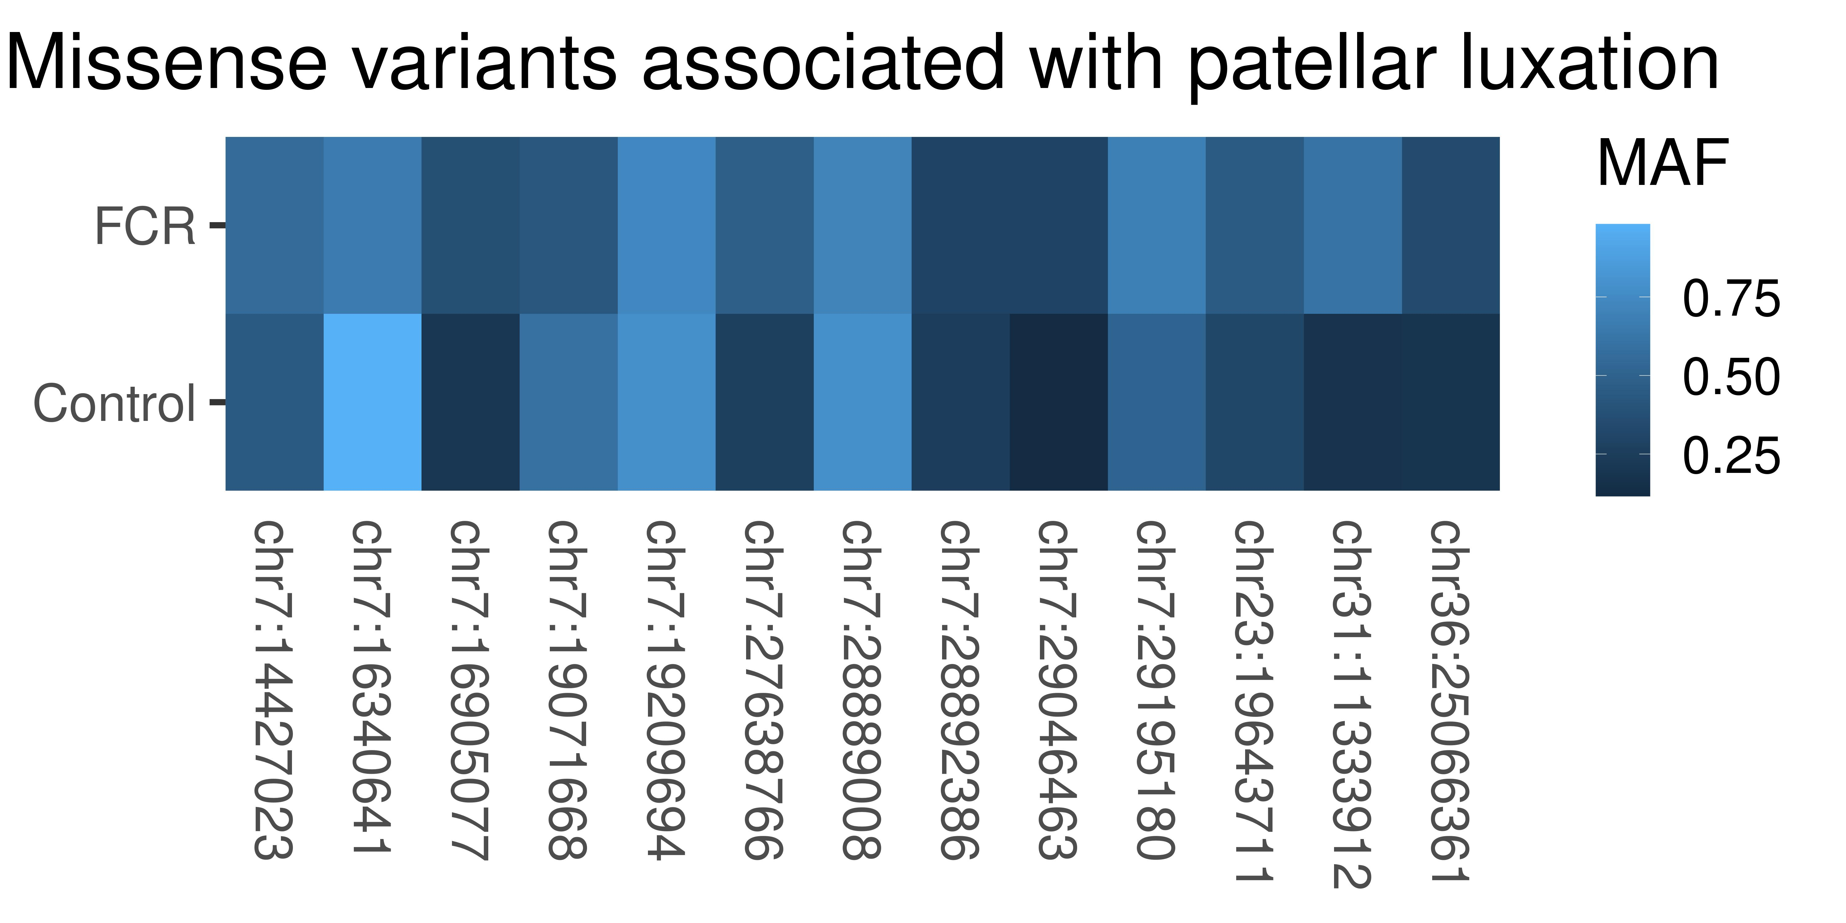
Variants in genes associated with patella luxation (72 SNPs)
ASPN | BRAF | C6 | CCL5 | CD9 | CDKN2A | CDKN2B | CLEC12A | Col3A1 | ENPEP | GTSF1 | JCHAIN | LUM | PHYH | PIK3CA | PPBP | PTEN | PTPN11 | RB1 | S100A12 | S100A8 | SPIC | THY1 | TKTL1 | TP53 | VCAM1 | DOK1 | CYP1B1 | NF1 | MYC | MYC | RAF1 | BACH2 | PCF11 | DENND2C | SERPINF2 | NCOA2 | DCTN4 | KIF2C | BASP1 | DOK2 | DOK3
Variants with MAF_{FCR}≥0.1
64 in total
13 missense variants
SHCBP1L
HMCN1
SELE
KIAA1614
ENSCAFG00000044662
FMO2
THRB
F5
SMG7
BLZF1
ITPRID2
Notes:
chr31:11333912

Slide 21
Flat-Coated Retriever health and disease surveillance study
QUESTIONS?
Thanks to
Maja Arendt & Erik Axelsson
for helping me interpret the data and setting up the analyses
Notes:
Only 3 homozygotes controls, 1 fcr.
Control 3 hom, 8 het and 143 hom ref
1 10 8
Not investigated paralogues yet
Publikationer ud af dataen
Hvilke som mut review generelt.
Andet review?
cfDNA scoping review.

